Slide 1

NAME: E.G.PRADEEP ROLL NO : RA2211004050026 DEP: B.TECH.ECE SUB: DESIGN THINKING METHODOLOGY SUB CODE : 21DCS201P

Slide 2
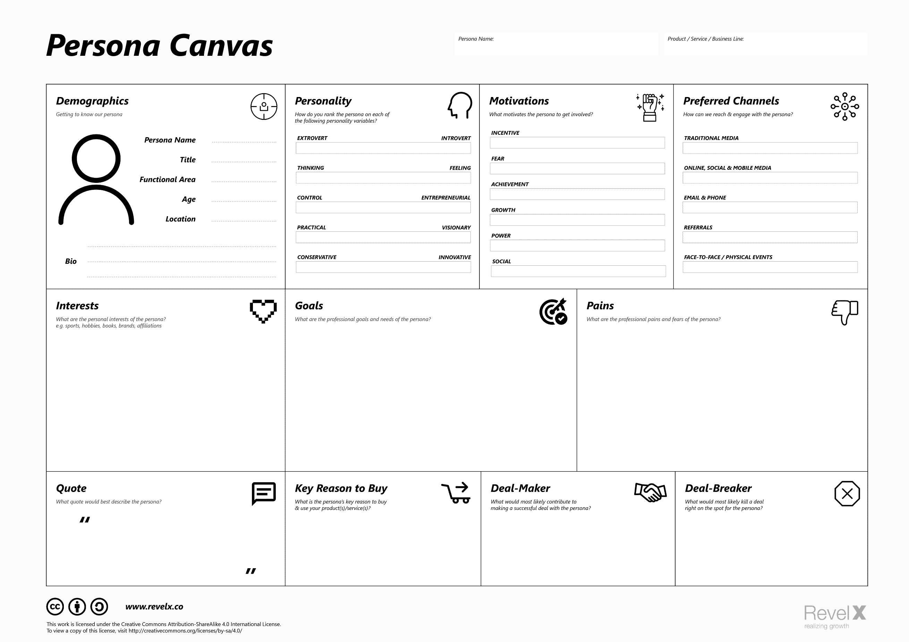
PERSONA CANVAS TEMPLATE:

Slide 3
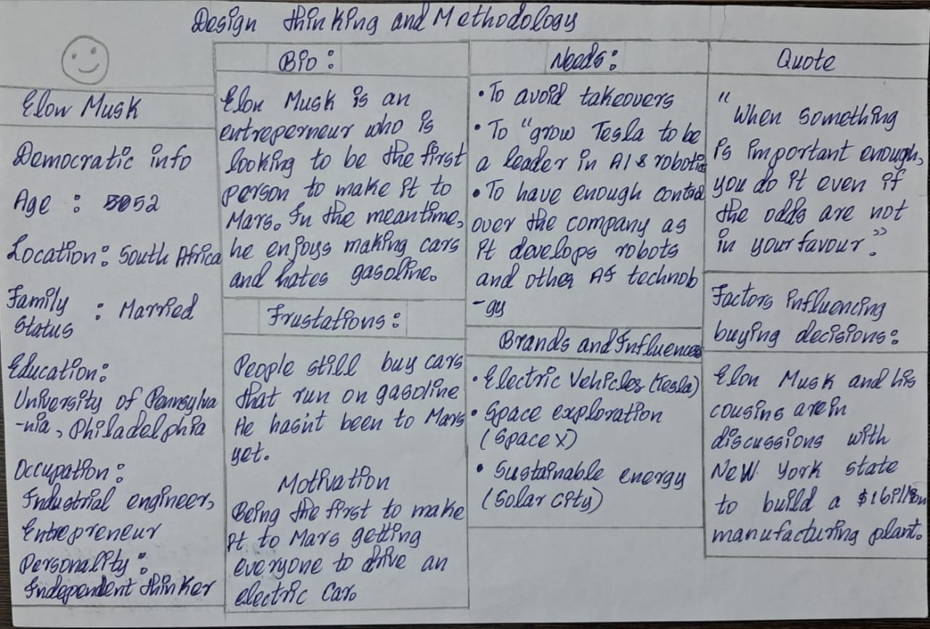
MY ASSIGNMENT :

Slide 4
THANK YOU

